Slide 1
Micro frontend architecture
Practical introduction to tools and patterns that are used to create frontend microservices

Slide 2

About me
I’ve been working in Vonage (NVM) since March of 2019.
Before that, I used to code in Nokia, Credit Suisse or Citi.
Love Javascript and C#
In free time, I travel, work out and rave!

Slide 3
Agenda
What is the goal of the presentation?
Introduction to the idea of frontend microservices
Solutions and patterns
Case study – micro frontends in New Voice Media
Architecture
Application flow
Testing and development
Summary
Notes:
A true single-stack provider has the breadth and depth to not only bring unified communications and contact center together, but to also bridge the two with APIs and integrations that create a customized, programmable workhorse that keeps all teams across your business in sync and with a clear picture of both internal and customer communications.

Slide 4
What is the presentation about?
After the presentation you should answer to these questions:
Idea behind micro frontends?
What are available solutions and patterns for building one consistent app from many decoupled microservices?
What is the architecture of the application and how to deal with routing?
How to test the same microservice in different context (as a standalone app or as a part of the whole product)?
Notes:
A true single-stack provider has the breadth and depth to not only bring unified communications and contact center together, but to also bridge the two with APIs and integrations that create a customized, programmable workhorse that keeps all teams across your business in sync and with a clear picture of both internal and customer communications.

Slide 5
Why do we need Micro Frontends?
The problems with monolith solution:
Does not scale well
One technology per whole frontend
Large codebase and complexity
Many teams working on separate features but still coupled
Different development cycles, working modes
Long build time, page loading time, perf issues
probably much more …
Notes:
A true single-stack provider has the breadth and depth to not only bring unified communications and contact center together, but to also bridge the two with APIs and integrations that create a customized, programmable workhorse that keeps all teams across your business in sync and with a clear picture of both internal and customer communications.

Slide 6
General idea
PARENT APP
Micro Frontend
Micro Frontend
…
Micro Frontend
Micro Frontend
Micro Backend
Micro Backend
Micro Backend
Micro Backend
TEAM 1
TEAM 2
TEAM X
TEAM Y
Notes:
A true single-stack provider has the breadth and depth to not only bring unified communications and contact center together, but to also bridge the two with APIs and integrations that create a customized, programmable workhorse that keeps all teams across your business in sync and with a clear picture of both internal and customer communications.

Slide 7
How to build it? Solutions and patterns
Most know solutions are:
Facebook BigPipe
Zalando Mosaic9
Old good Iframes
Web Components
Varniche Cache and ESI (Allegro)
Others (check the source)
Source: https://medium.com/@tomsoderlund/micro-frontends-a-microservice-approach-to-front-end-web-development-f325ebdadc16
Notes:
A true single-stack provider has the breadth and depth to not only bring unified communications and contact center together, but to also bridge the two with APIs and integrations that create a customized, programmable workhorse that keeps all teams across your business in sync and with a clear picture of both internal and customer communications.

Slide 8
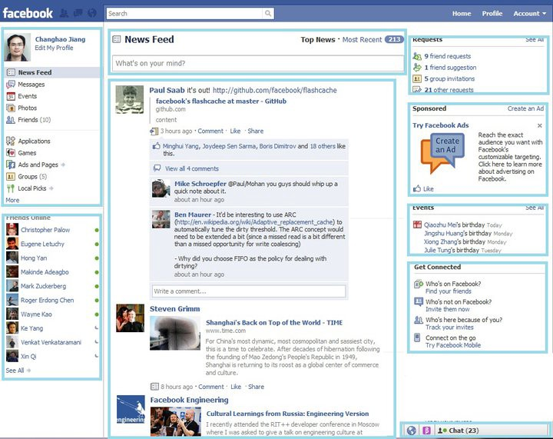
BigPipe
Source: https://www.facebook.com/notes/facebook-engineering/bigpipe-pipelining-web-pages-for-high-performance/389414033919/
Notes:
A true single-stack provider has the breadth and depth to not only bring unified communications and contact center together, but to also bridge the two with APIs and integrations that create a customized, programmable workhorse that keeps all teams across your business in sync and with a clear picture of both internal and customer communications.

Slide 9
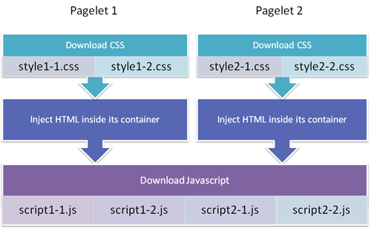
BigPipe
Source: https://itswadesh.wordpress.com/2011/12/23/facebook-loads-web-pages-faster-using-bigpipe-technology/
Notes:
A true single-stack provider has the breadth and depth to not only bring unified communications and contact center together, but to also bridge the two with APIs and integrations that create a customized, programmable workhorse that keeps all teams across your business in sync and with a clear picture of both internal and customer communications.

Slide 10
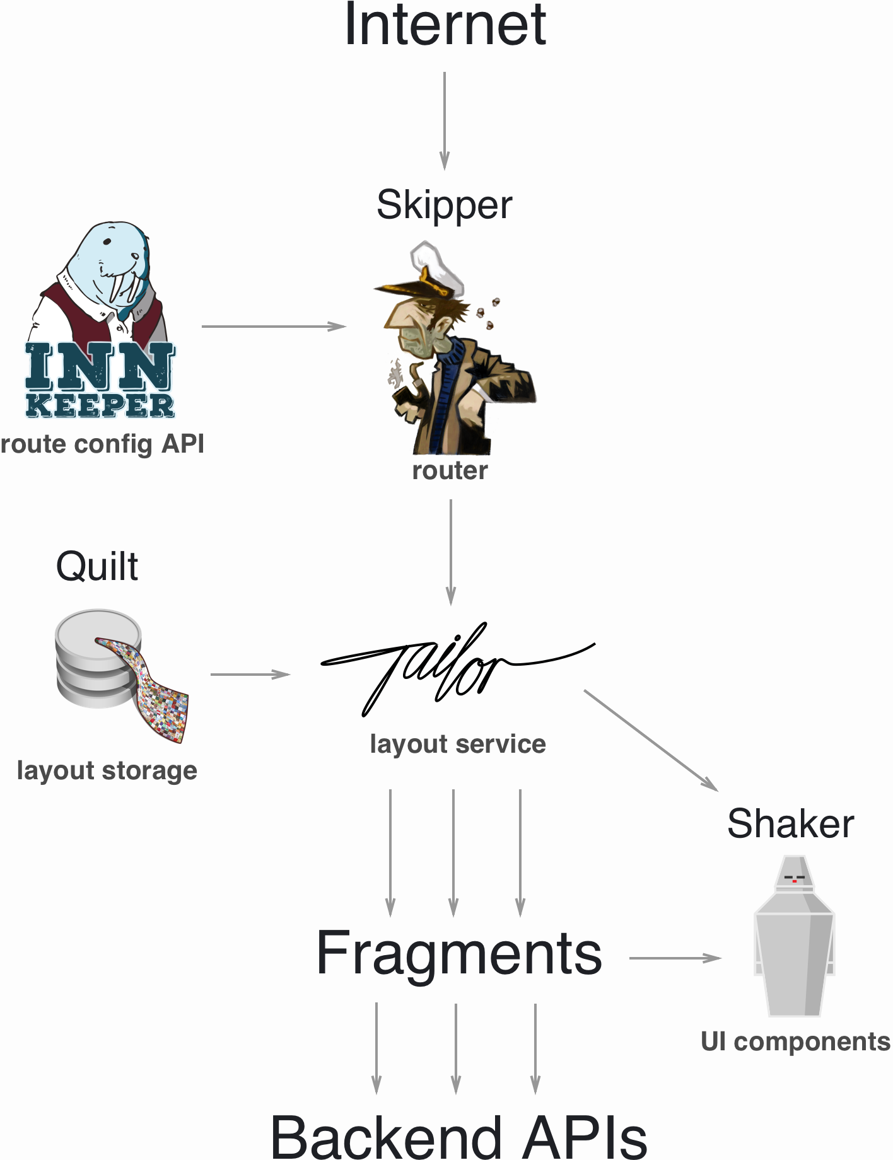
Mosaic9
Source: https://www.mosaic9.org/
Notes:
A true single-stack provider has the breadth and depth to not only bring unified communications and contact center together, but to also bridge the two with APIs and integrations that create a customized, programmable workhorse that keeps all teams across your business in sync and with a clear picture of both internal and customer communications.

Slide 11
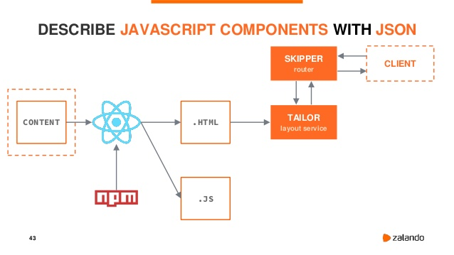
Mosaic9
Source: https://www.mosaic9.org/
Notes:
A true single-stack provider has the breadth and depth to not only bring unified communications and contact center together, but to also bridge the two with APIs and integrations that create a customized, programmable workhorse that keeps all teams across your business in sync and with a clear picture of both internal and customer communications.

Slide 12
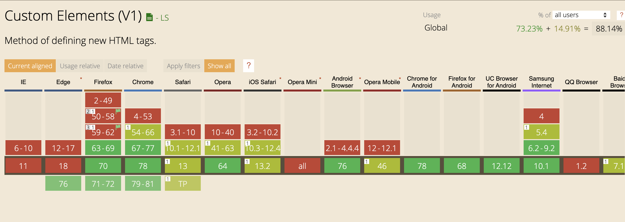
Web Components – browser support
Source: https://micro-frontends.org/ https://medium.com/javascript-in-plain-english/create-micro-frontends-using-web-components-with-support-for-angular-and-react-2d6db18f557a
Notes:
A true single-stack provider has the breadth and depth to not only bring unified communications and contact center together, but to also bridge the two with APIs and integrations that create a customized, programmable workhorse that keeps all teams across your business in sync and with a clear picture of both internal and customer communications.

Slide 13
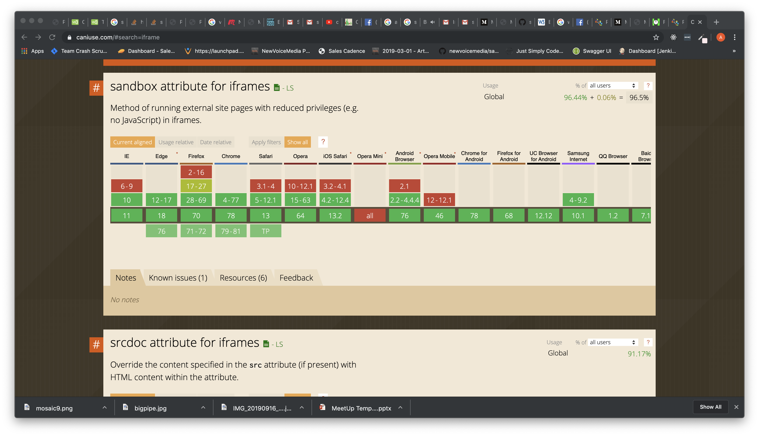
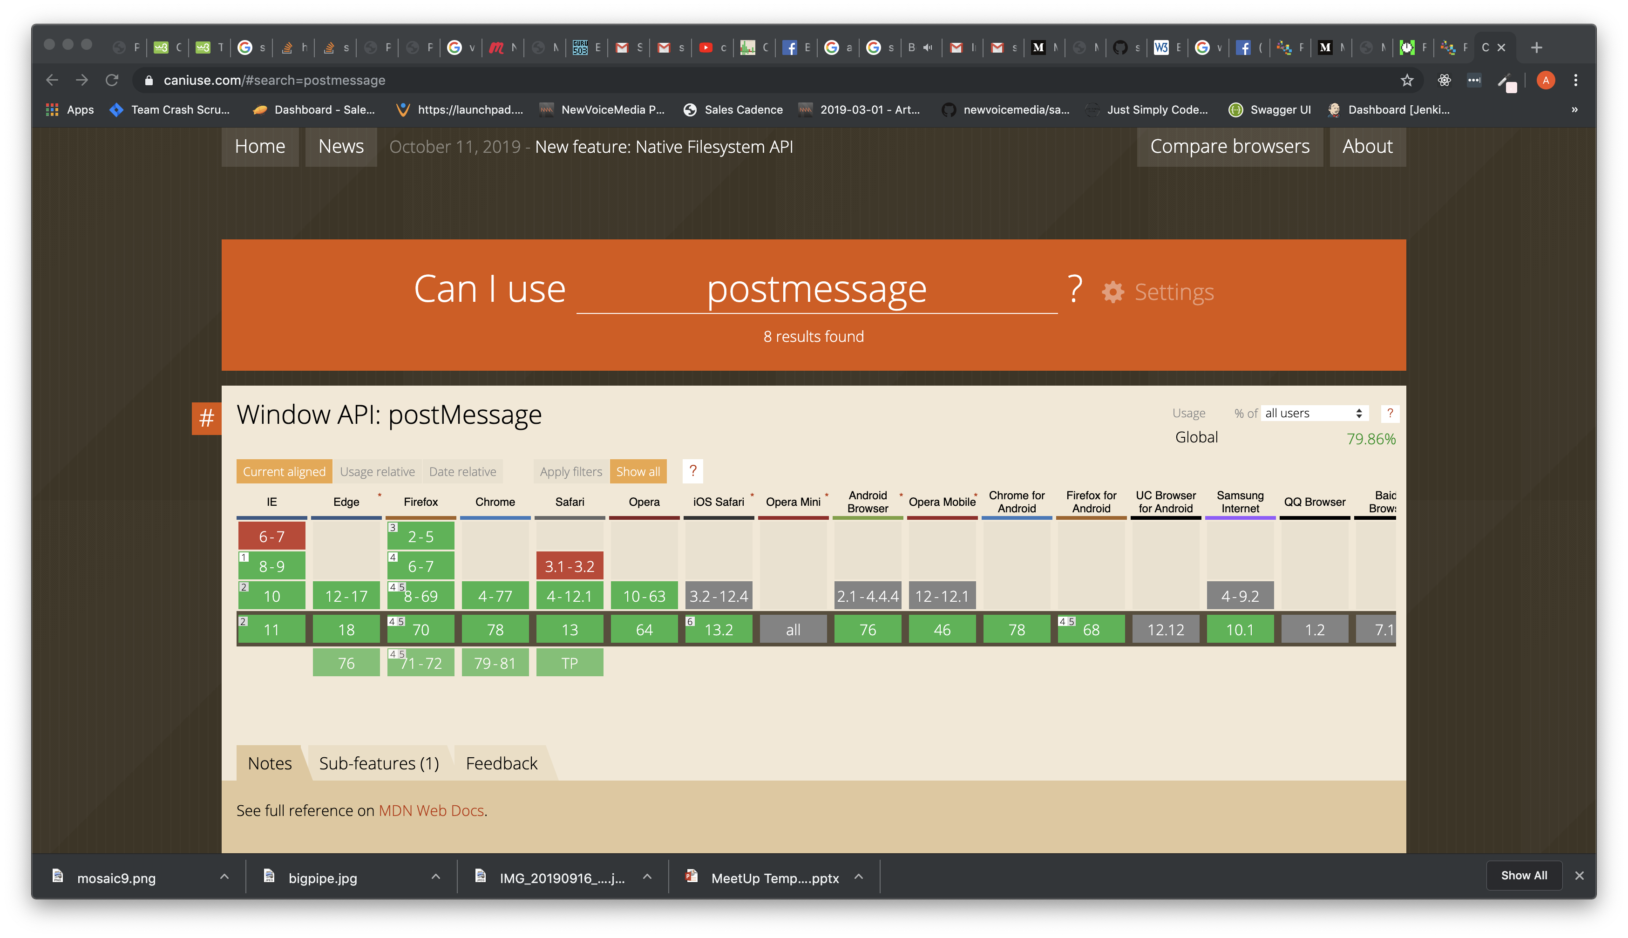
Iframe – browser support
Notes:
A true single-stack provider has the breadth and depth to not only bring unified communications and contact center together, but to also bridge the two with APIs and integrations that create a customized, programmable workhorse that keeps all teams across your business in sync and with a clear picture of both internal and customer communications.

Slide 14
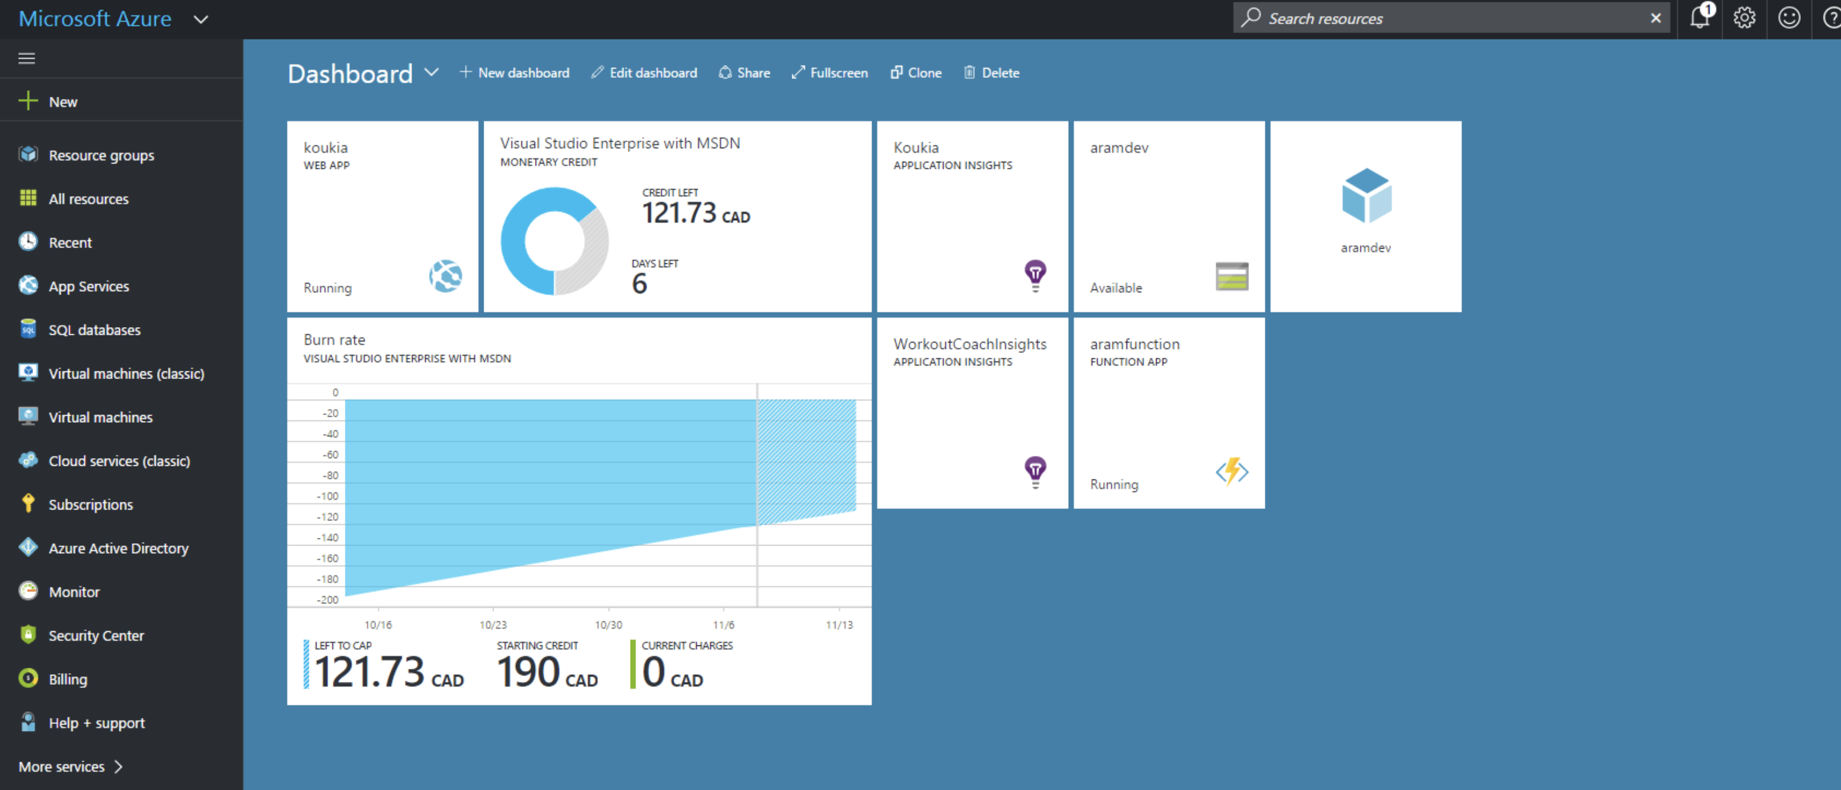
Apps based on Iframe solution - examples
Source: http://jbeckwith.com/2014/09/20/how-the-azure-portal-works//
Notes:
A true single-stack provider has the breadth and depth to not only bring unified communications and contact center together, but to also bridge the two with APIs and integrations that create a customized, programmable workhorse that keeps all teams across your business in sync and with a clear picture of both internal and customer communications.

Slide 15
Case study
Repo:
https://bit.ly/32cDCr6
or https://github.com/arturgieralt/microservices
Notes:
Five-second elevator pitch

Slide 16
Iframe solution architecture
PARENT APP
ROUTE MANAGER
IFRAME
Micro Frontend
Micro Frontend
Window.postMessage API
Micro Backend
Micro Backend
TEAM 1
TEAM 2
Notes:
A true single-stack provider has the breadth and depth to not only bring unified communications and contact center together, but to also bridge the two with APIs and integrations that create a customized, programmable workhorse that keeps all teams across your business in sync and with a clear picture of both internal and customer communications.

Slide 17
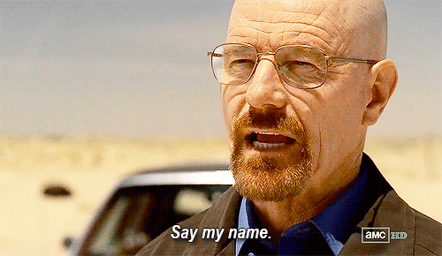
Routing - naming issue
Each app has its own routing.
Microservices should not be aware of their name, „parent” service should manage it
Route Manager component maps each service’s name to url and pass it to the Iframe.
(one of the microservices asking for its name)
Notes:
Includes the basic, “must-have” call center functionality, including call routing, softphone call controls, and dashboards and reports.

Slide 18
Application flow
USER
1
PARENT APP
2
MICROSERVICE 1
3
4
6
5
User hits url for service1: http://localhost/portal/service1
Parent app maps ‚service1’ name to url, loads service using Iframe and sends data to it (name and token for example)
Microservice dynamically sets up its Routing using name provided by Parent App and renders correct page
Notes:
Includes the basic, “must-have” call center functionality, including call routing, softphone call controls, and dashboards and reports.

Slide 19
Application flow
USER
1
PARENT APP
2
MICROSERVICE 1
3
4
6
5
User navigates to different page in Microservice1
Microservice1 notifies Parent APP about url change through postMessage API
Parent app listens to ‚message’ event and handles URL change, it shows correct address in the browser
Notes:
Includes the basic, “must-have” call center functionality, including call routing, softphone call controls, and dashboards and reports.

Slide 20


Testing environment
Notes:
Includes the basic, “must-have” call center functionality, including call routing, softphone call controls, and dashboards and reports.

Slide 21
Tricky part – end to end testing
How to test one app in two contexts?
We develop our microservice as a standalone application, but we’d like to test it end-to-end with Parent Service as well.
Should we write each test twice?
Thanks to custom commands in Cypress, we do not need to.
Notes:
Includes the basic, “must-have” call center functionality, including call routing, softphone call controls, and dashboards and reports.

Slide 22
End to end testing - flow
Run Cypress in specified environment (standalone or integrated app)
Cypress checks in config what URL we use and if app is served in Iframe
Invoke Custom command
Pass tests ;)
Notes:
Includes the basic, “must-have” call center functionality, including call routing, softphone call controls, and dashboards and reports.

Slide 23
Summary
Microservices vs monolith
Available solutions
Case study
Testing
Q & A
Notes:
Includes the basic, “must-have” call center functionality, including call routing, softphone call controls, and dashboards and reports.

Slide 24
Thank you
And thanks to my Vonage crew!
Author: Artur Gierałt

